Slide 1
PHY 202- Electric Circuits and Electronics

Slide 2
PHY 202- Electric Circuits and Electronics
Lecturers:
Dr. Adeleye
Dr. Oyelade
Room 16, Postgraduate Block, laradele04@gmail.com
Course contents
Introduction to semiconductors, the pn-junction, Field effect transistors, Bipolar junction transistors, Characteristics & equivalent circuits, amplifiers, Feedback, Oscillators

Slide 3
Success principle
Your dream is very fragile, just like a little bird. It is your decision to kill it or allow others and circumstances to steal it away from you. However, it is also your choice to nurture it and let it grow to fruition. Success comes to those who allow their dreams to fly high, just like a little bird, which will soar into the sky if released from the cage.

Slide 4
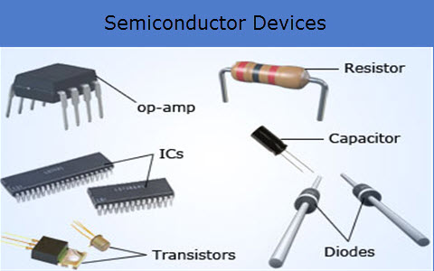
Semiconductors
Semiconductor devices e.g. transistors and integrated circuits are found everywhere: mobile phones, televisions, automobiles, washing machines and computers

Slide 5
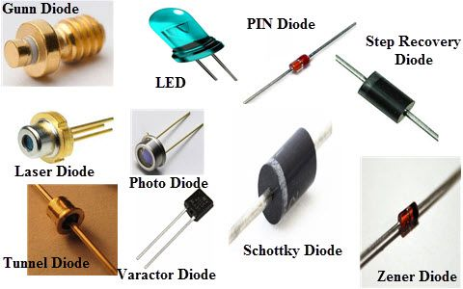
Semiconductors

Slide 6
Introduction
Semiconductors are materials whose electrical properties lie between Conductors and Insulators.
Elemental semiconductors : Silicon (Si) and Germanium (Ge)-(column IV of periodic table)
Compound semiconductors : Gallium Arsenide (GaAs) and Cadmium Telluride (CdTe)
=> Give the examples of Conductors and Insulators!
=>The wide variety of electronic and optical properties of these semiconductors makes its engineering flexible.

Slide 7
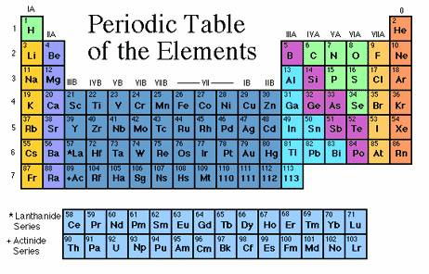

Slide 8
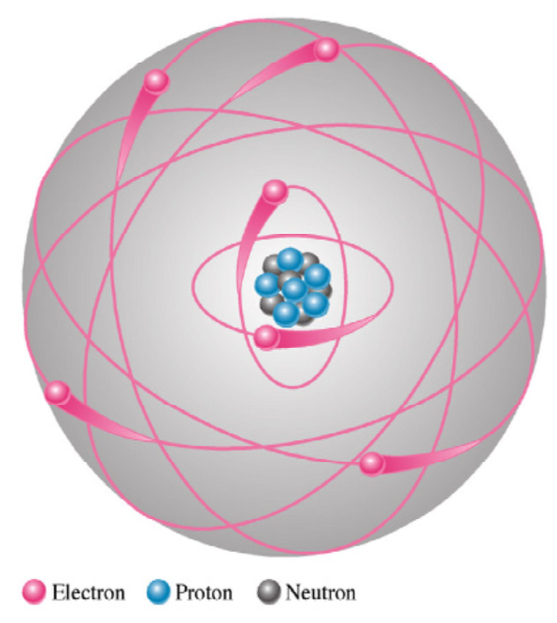
The Atomic Structure
Atom is the smallest particle of an element that retains the characteristics of that element.
An atom consists of the protons and neutrons that make up the nucleus (core) at the centre and electrons that orbit about the nucleus.
The nucleus carries almost the total mass of the atom.
Neutrons are neutral and carry no charge.
Protons carry positive charges.
The electrons carry negative charges.
The number of protons = the number of electrons in an atom, which makes it electrically neutral or balanced.
Bohr Model

Slide 9
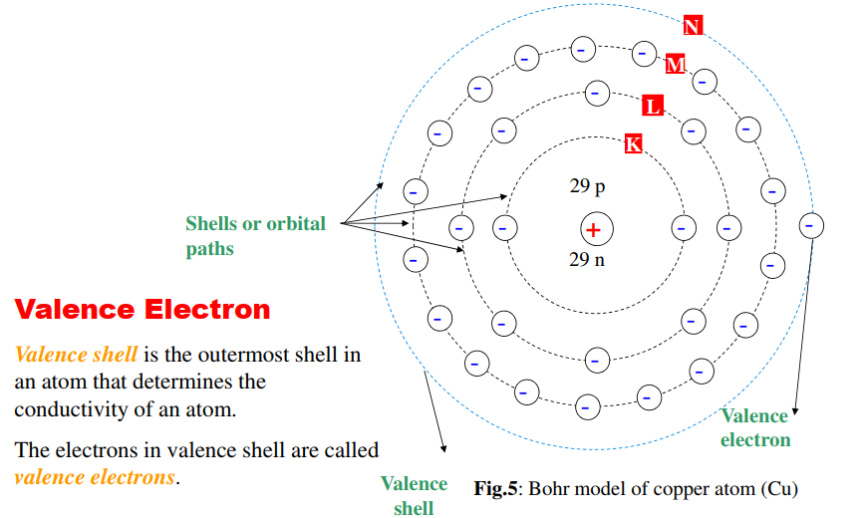
The Atomic Structure

Slide 10
The Atomic Structure
Element in periodic table are arranged according to atomic number .
Atomic number = number of protons in nucleus which is the same as the number of electron in an electrically balanced atom.
Electrons near the nucleus have less energy than those in more distant orbits.
Each distance (orbits) from the nucleus corresponding to a certain energy level.
In an atom, the orbits are group into energy bands – shells
Valence shell is the outermost shell in an atom that determines the conductivity of an atom.
The electrons in valence shell are called valence electrons.

Slide 11
The Atomic Structure
When atom absorb energy (e.g heat source) the energies of the electron are raised.
Valence electrons obtain more energy and are more loosely bound to the atom compared to the inner electrons.
If a valence electron acquires sufficient energy, it escapes from the outer shell. This process of losing valence electron is called ionization.
An ion is an atom or molecule that does not have a neutral net charge, i.e., the numbers of protons and electrons are not equal. If it loses electrons, resulting in a net positive charge, it is called a cation. If it gains electrons resulting in a net negative charge it is called an anion.
The electron that escapes from the valence shell is called free electron.

Slide 12

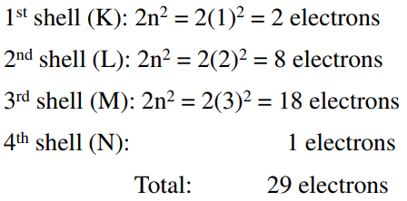
The Atomic Structure
The Number of Electrons in Each Shell
The maximum number of electrons (Ne) in each shell is calculated using:
where n = number of shell
Example for the Copper atom (Cu) shell :
Calculate the number of electrons on each shell for Ge=32 and Sn=50

Slide 13
Semiconductors, Conductors and Insulators
All materials are made up of atoms that contribute to its ability to conduct electrical current.
In terms of electrical properties materials are divided into Semiconductors, Conductors and Insulators.
Conductors
Good conductors have low resistance so electrons flow through them with ease.
Best element conductors include: Copper, silver, gold, aluminum, & nickel. They have only one valence electron which is loosely bound to the atom i.e (one free electron).
Alloys are also good conductors: Brass & steel
Good conductors can also be liquid: Salt water

Slide 14
Semiconductors, Conductors and Insulators
Insulators
Insulators have a high resistance so current does not flow in them.
Good insulators include: Glass, ceramic, plastics, & dry wood
Most insulators are compounds of several elements.
The atoms are tightly bound to one another so electrons are difficult to strip away for current flow
Semiconductors
Semiconductors are materials that essentially can be conditioned to act as good conductors or good insulators
Common elements such as carbon, silicon, germanium and Galium arsenide are semiconductors.
Silicon is the best and most widely used semiconductor.
Semiconductors have four valence electrons.

Slide 15
Gallium Arsenide (GaAs)
Next to silicon, the second most common semiconductive material is gallium arsenide, GaAs.
GaAs is a crystalline compound, not an element.
Its properties can be controlled by varying the relative amount of gallium and arsenic.
GaAs has the advantage of making semiconductor devices that respond very quickly to electrical signals. This makes it better than silicon for applications like amplifying the high frequency (1 GHz to 10 GHz) signals from TV, satellites, etc.
The main disadvantage of GaAs is that it is more difficult to make and the chemicals involved are quite often toxic!

Slide 16
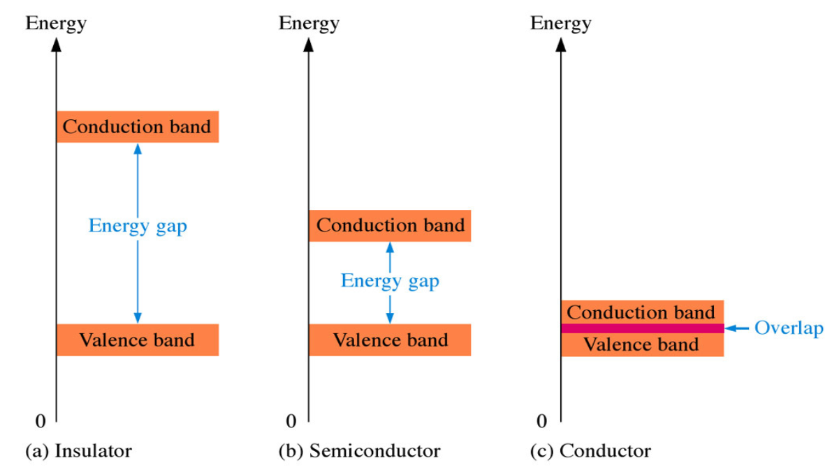
Energy Band Diagrams for Semiconductors, Conductors and Insulators

Slide 17
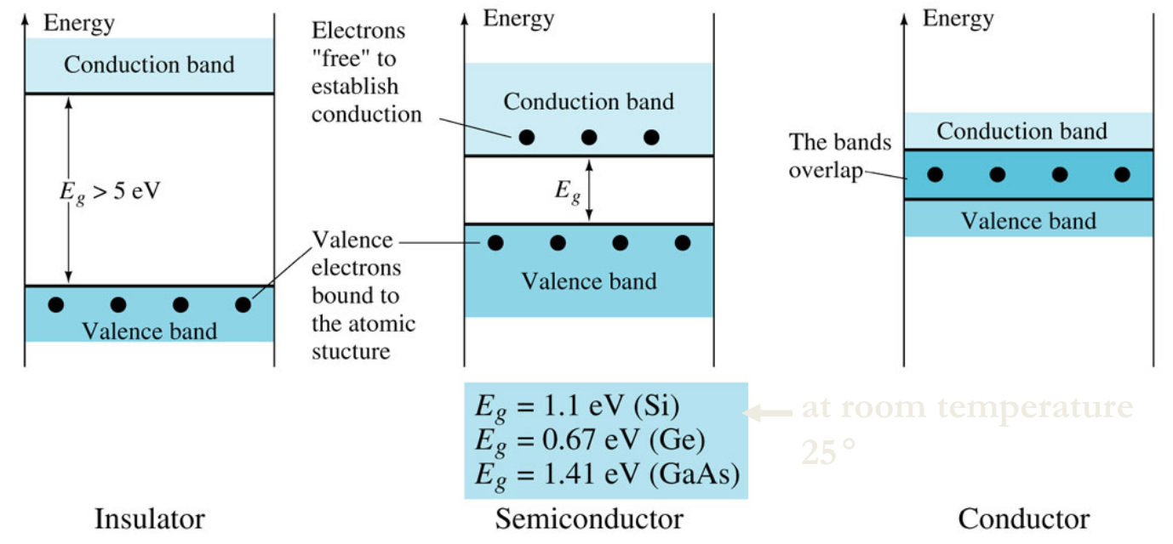
Band Diagrams for Semiconductors, Conductors and Insulators

Slide 18
The Energy Diagram of Materials
An atom comprises the nucleus and electrons arranged in shells (allowed orbits) around the nucleus.
The number of electrons in the shells are quite unique to the atoms of the particular element/material.
The electrons in a single atom have discrete energy levels.
Materials contain innumerable number of atoms packed together and their energy levels overlap to form bands.
There will be bands comprising allowable energy levels very close to one another, and other forbidden energy bands.
The lowest available energy band is called the valence band (VB) & the next available energy band is the conduction band (CB).
The band diagrams enables us to distinguish conductors, insulators, and semiconductors.

Slide 19
The Energy Diagram of Materials
At low temperatures VB is completely filled up whereas CB is completely empty.
Neither completely filled nor completely empty bands contribute to flow of electrons.
Note that:
For conductors VB and CB overlap, so conducts electricity.
For semiconductor VB and CB are relatively close, i.e., separated by small energy gap.
For insulators the energy gap is quite wide.
At low temperature both the semiconductor and insulator are similar, i.e., do not conduct electricity.

Slide 20
The Energy Diagram of Materials
At sufficiently high temperatures, semi conductors conducts.
Typical resistivity values are:
Conductors ~ 10⁻⁸ Ωm
Semi conductors ~ 10⁻¹ Ωm
Insulators ~ 10⁴ Ωm
Electrons in the VB can acquire sufficient energy (e.g., from sunlight) to surmount the energy gap and jump to the CB. It leaves behind a vacancy or hole.
Electrons adjacent to this hole can move into it creating a new hole. In the VB therefore there is a movement of holes, and the CB there is motion of the electrons.
In semiconductors current flow is due to motion of both electrons and holes while current flow in conductors is due to motion of electrons

Slide 21
The Energy Diagram of Materials
Band - another name for an orbital shell (valence shell=valence band)
Conduction band – the band of electron orbitals that electrons jump into from valence band when excited.
Valence band – the of electron orbitals that electrons can jump out of moving into the conduction band when excited. It is simply the outermost orbital of an atom of any specific material that electrons actually occupy.
Energy/band gap – the minimum energy required to excite an electron that is in the valence band (bound state) to the conduction band (free state) where it can participate in conduction. It is the gap between the valence band and the conduction band.

Slide 22
Fermi level
Associated with the band gap is the concept of the Fermi level.
The Fermi level is the energy level in a given material at which there is a 50% probability that it is filled with electrons. Levels below this value tend to be filled with electrons and levels above tend to be empty.
If the Fermi level lies within a band, the material will be good a conductor. On the other hand, if the Fermi level lies between two widely separated bands, the material will be a good insulator.
If the Fermi level is between bands that are relatively close, the material is a semiconductor.
At absolute zero temperature, the crystal lattice is stable and there is no electron movement through the crystal. As thermal energy increases, it is possible for valence electrons to jump up to the conduction band and “wander” through the crystal

Slide 23
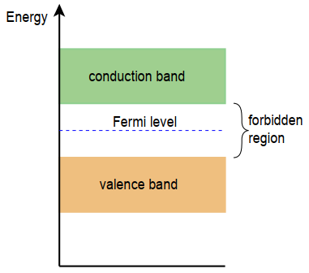
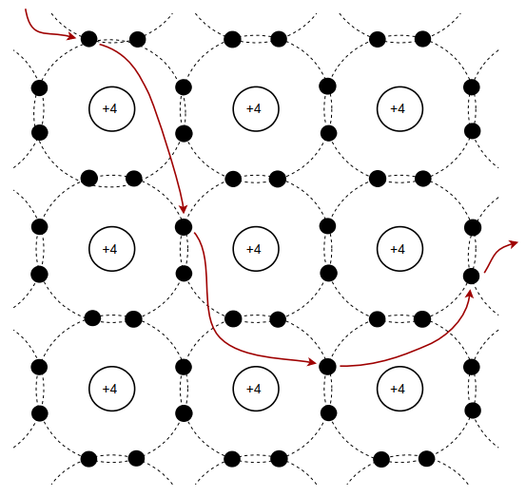
Energy diagram for an intrinsic semiconductor
Electron movement in a crystal

Slide 24
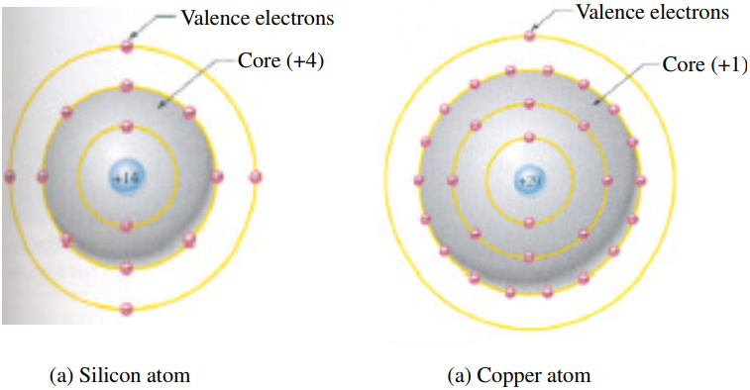
Comparison of a semiconductor atom to a conductor atom
Core of Si atom has a net charge of +4 and +1 for Cu atom.
A valence electron in Si atom feels an attractive force of +4 compared to Cu atom which feels an attractive force of +1.
Force holding valence electrons to the atom in Si > Cu.
The distance from its nucleus of Copper’s valence electron (in 4th shell) > silicon’s valence electron (in 3rd shell)

Slide 25
References
Semiconductor Devices: Theory and Application, by James M. Fiore Version 1.1.2, 2019
Electronic devices by Thomas L. Floyd. Pearson Education Inc. Prentice Hall Publisher, New Jersey, ISBN-13: 978-0-13-254986-8

